Slide 1

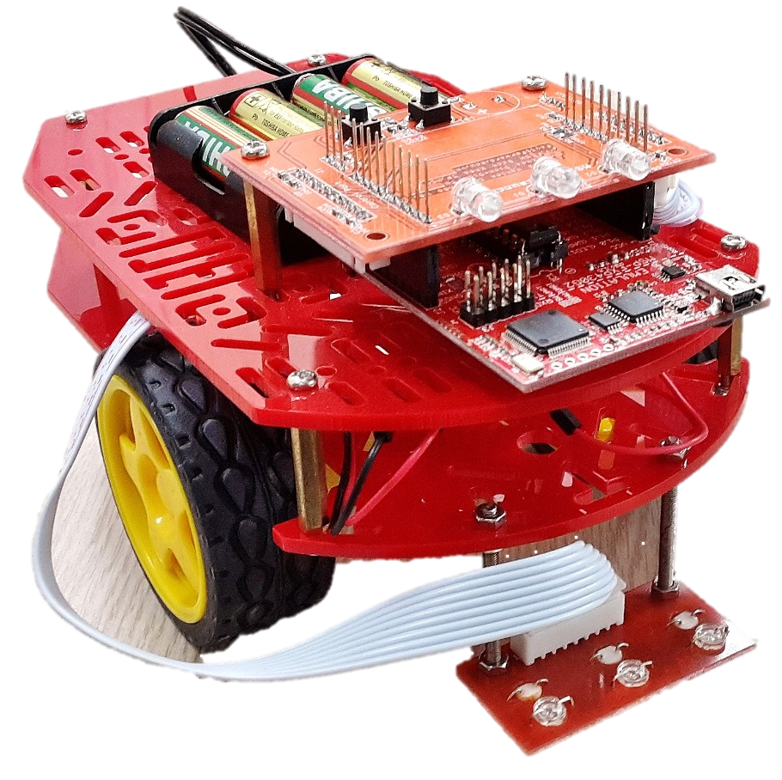

iBot Assembly Instructions
Ho Chi Minh City University of Technology
Faculty of Electrical and Electronics Engineering
Designed by FEEE Student Research Club - PayItForward

Slide 2
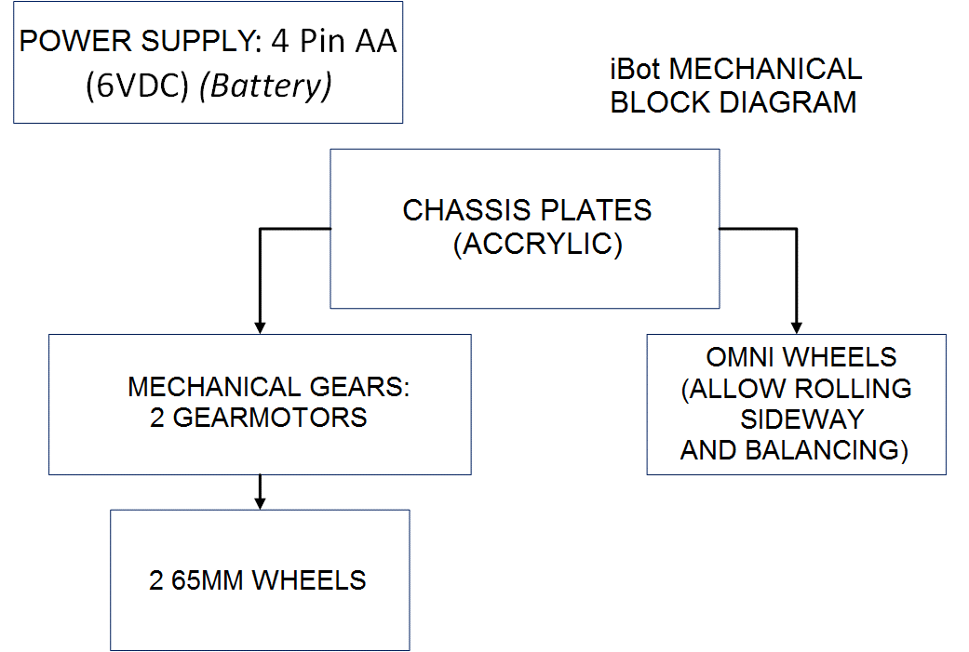
Specifications

Slide 3
Specifications
Measurement: 110 x 174mm
Technical specifications:
Maximum voltage for motor: 6VDC
No-load speed: 90±10rpm
No-load current: 190mA (max.250mA)
Torque: 800gf.cm
Stall Current: ~1A
Wheel diameter: 65mm (30mm Wide)

Slide 4
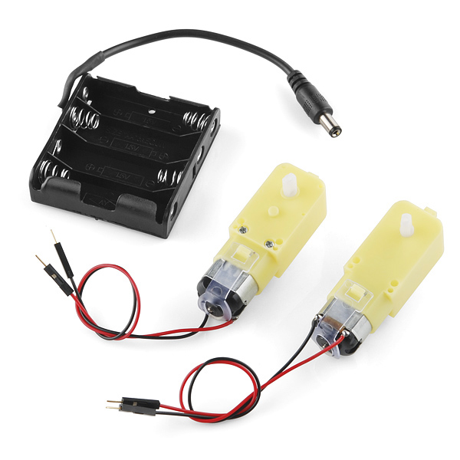
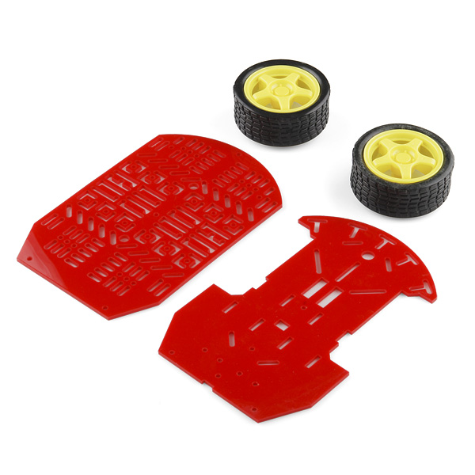
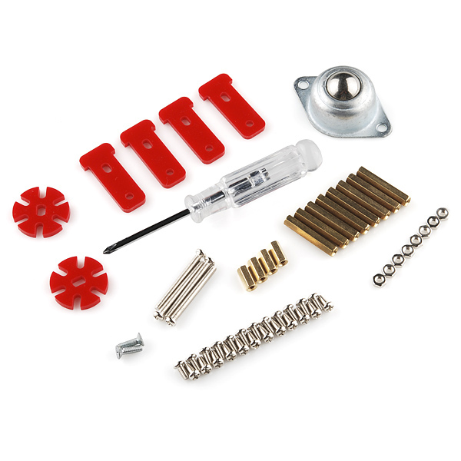
iBot Chassis
Magician Chassis Kit’s components: 2 DC Motor + Wheels + Encoder, omni wheel, 4 AA batteries package, acrylic plates and general mechanical items .

Slide 5
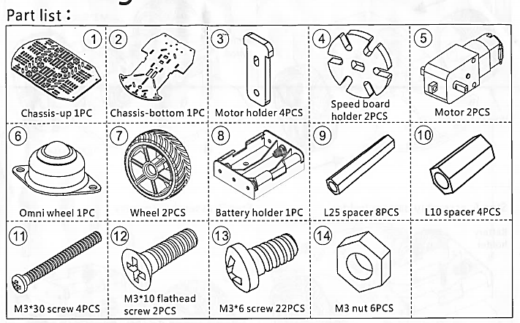
Magician Chassis Kit’s components:

Slide 6
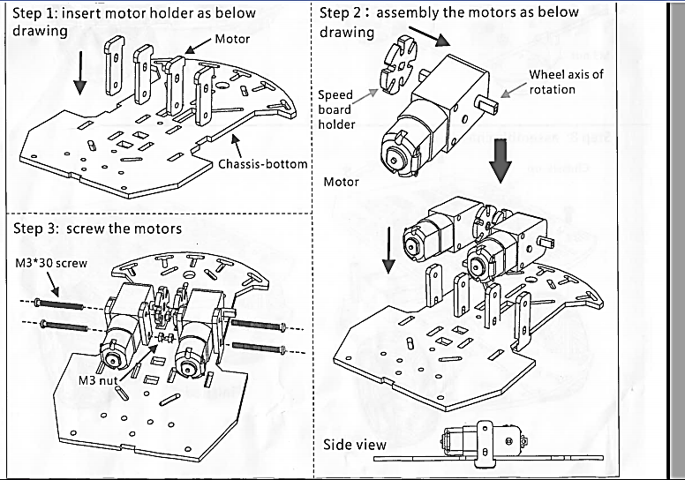
Assembly Instructions

Slide 7
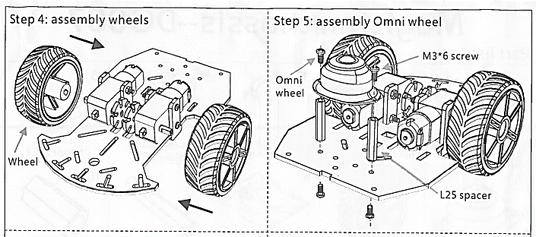
Assembly Instructions
1st week target: Complete Step 5 (Assembly Omni wheel)

Slide 8
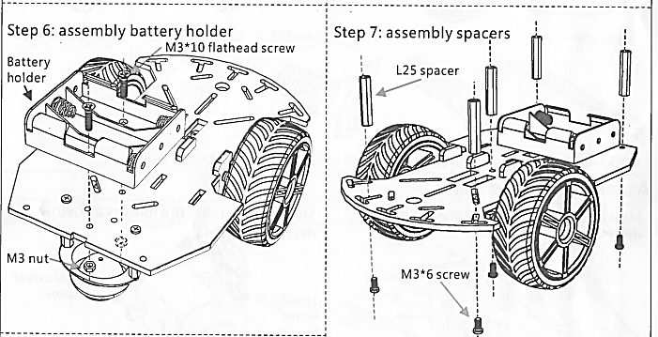
Assembly Instructions
Note: Participants will not assembly the battery holder in Step 6 (The battery holder is placed on top plate for easy replacement).
Instead, Power Circuit (Motor Control Circuit–H-bridge) will be placed at that position.

Slide 9
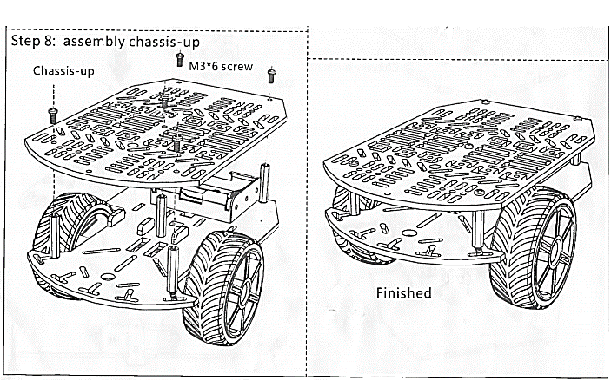
Assembly Instructions
Battery holder should be placed on top plate beside control circuits.

Slide 10
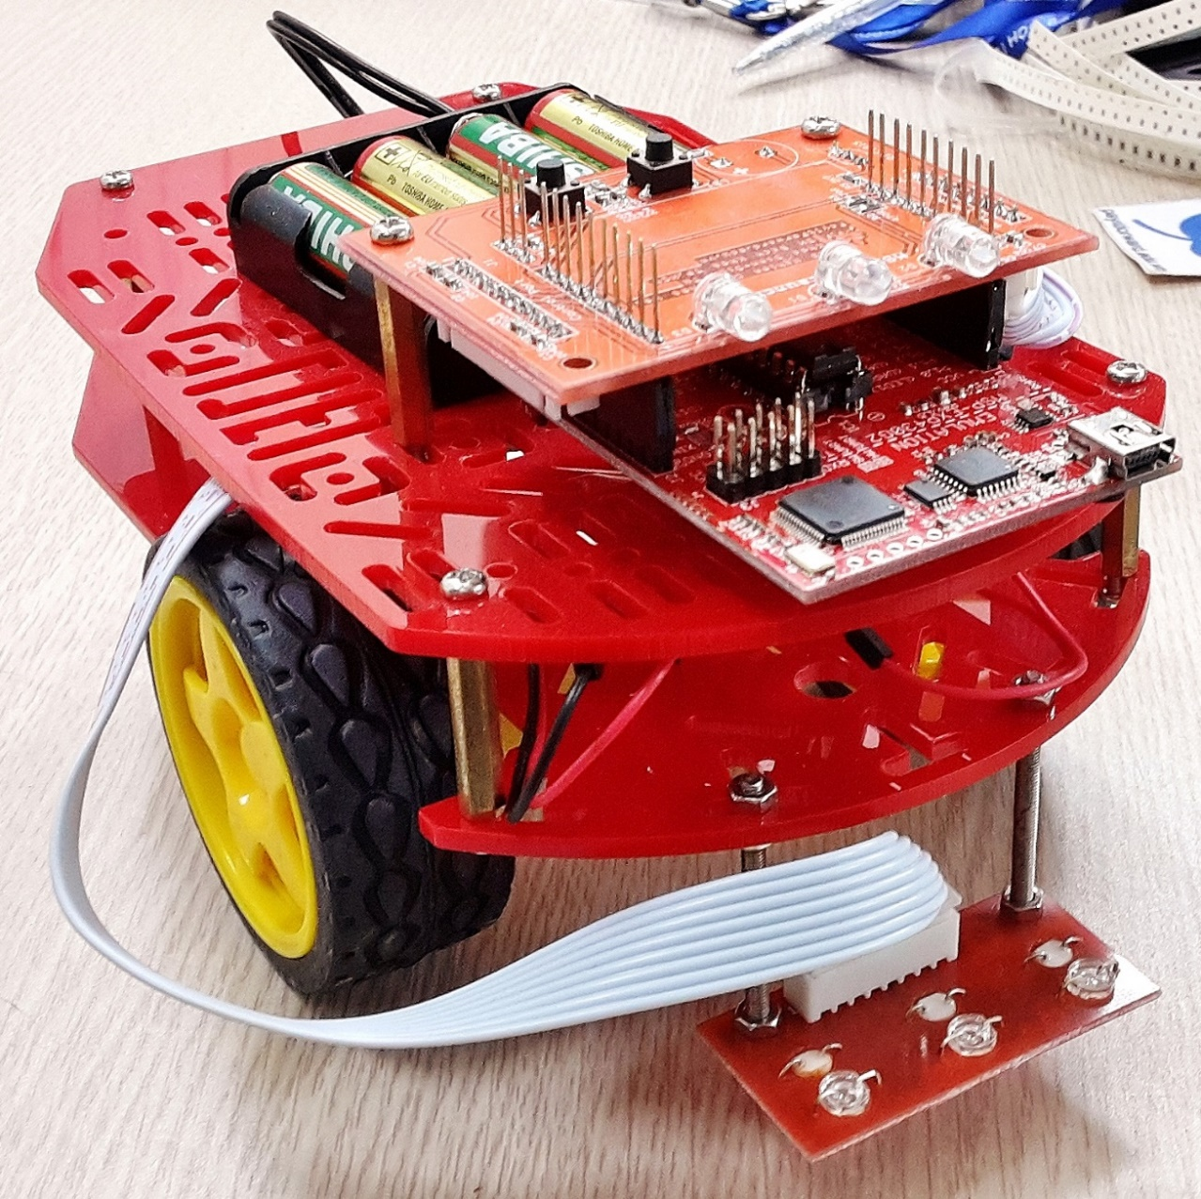
iBot Completed!

Slide 11
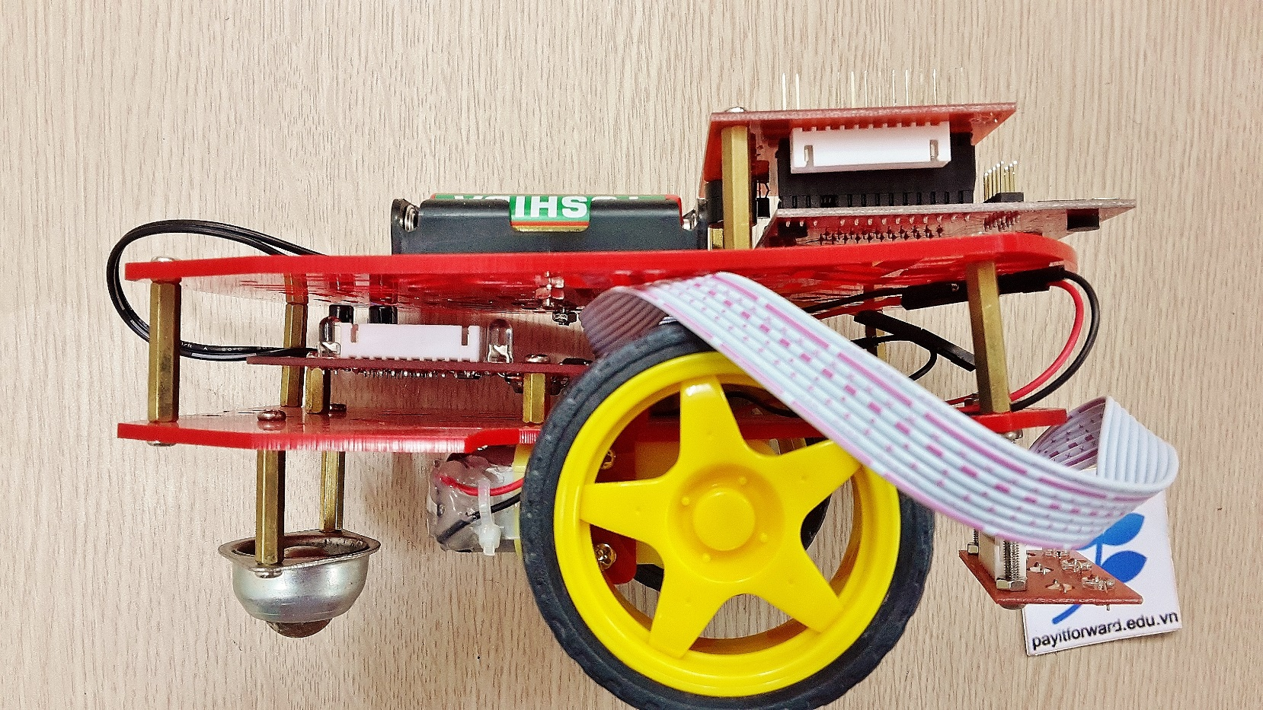
iBot After Final Assembly!
Power circuit is placed between 2 plates, battery holder on top, connecting wires from battery to power circuit as in the image below
Note: in this image there is a 10-wire signal bus connecting the power circuit to control circuit that will be disconnected (in lab student will have to connect it to the circuit)

